Slide 1
18CEO405T WATER POLLUTION AND ITS MANAGEMENT Dr. Karuppasamy Sudalaimuthu

Slide 2
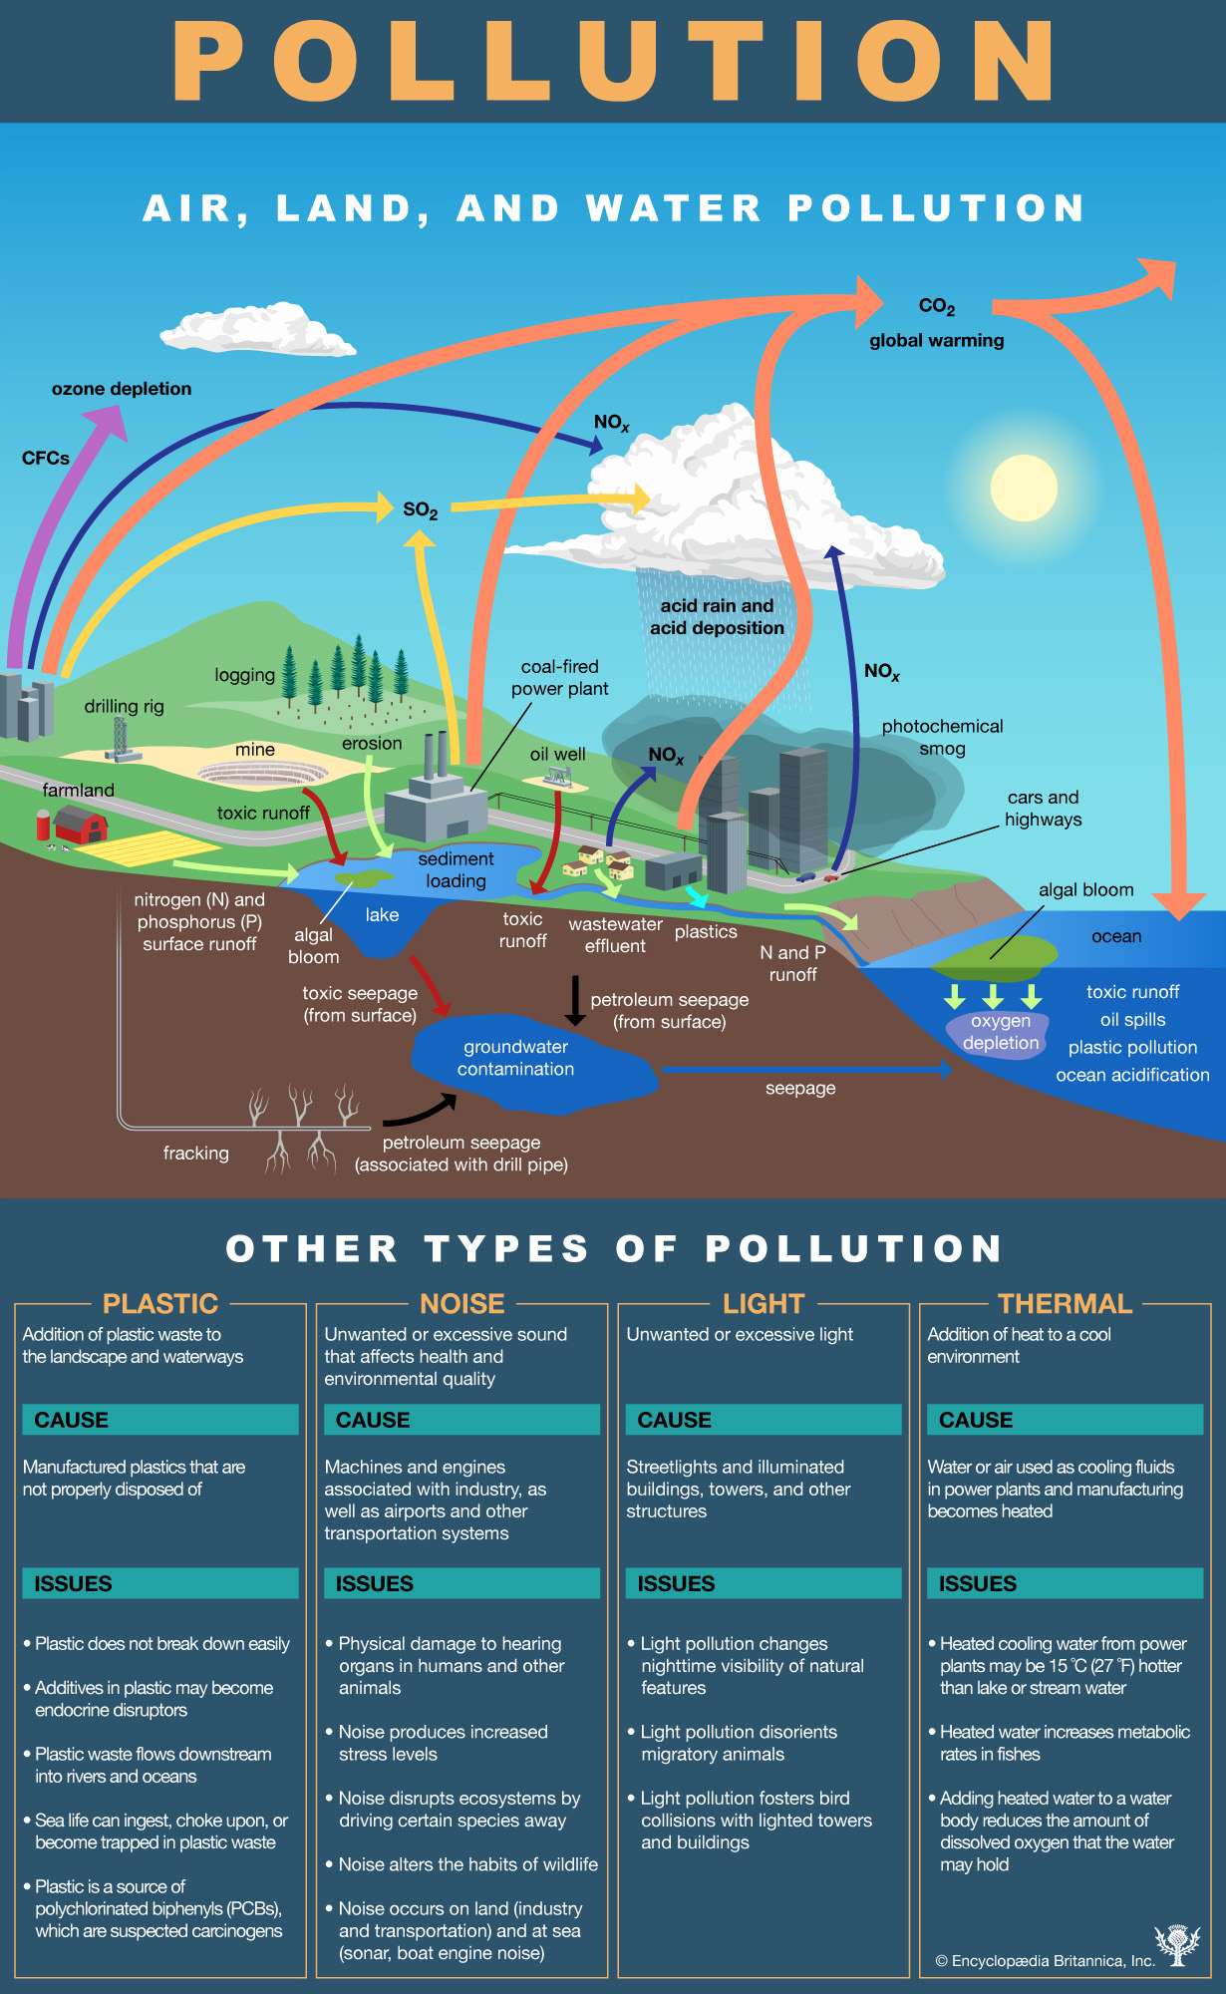

Slide 3
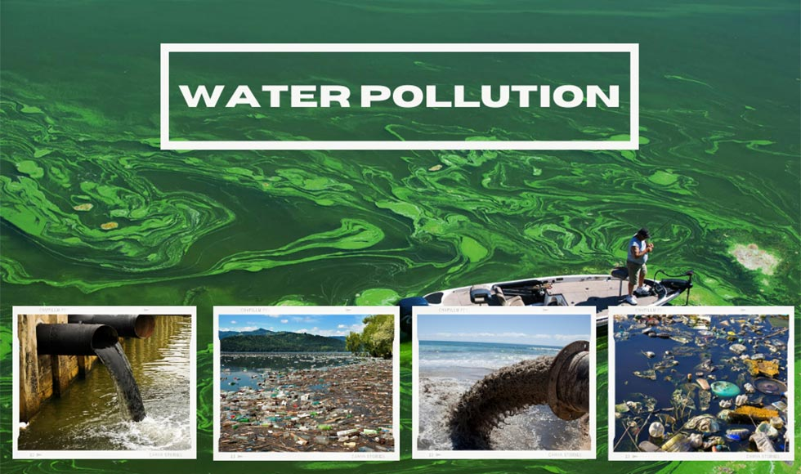

Slide 4
S1-SLO 1- Introduction to Water pollution
Introduction : Water Pollution
Water that has constituents of human and/or animal metabolic wastes.
Water that has the residuals from cooking, cleaning and/or bathing as a domestic
Water that has the residuals from manufacturing, processing, cleaning as a industrial.

Slide 5
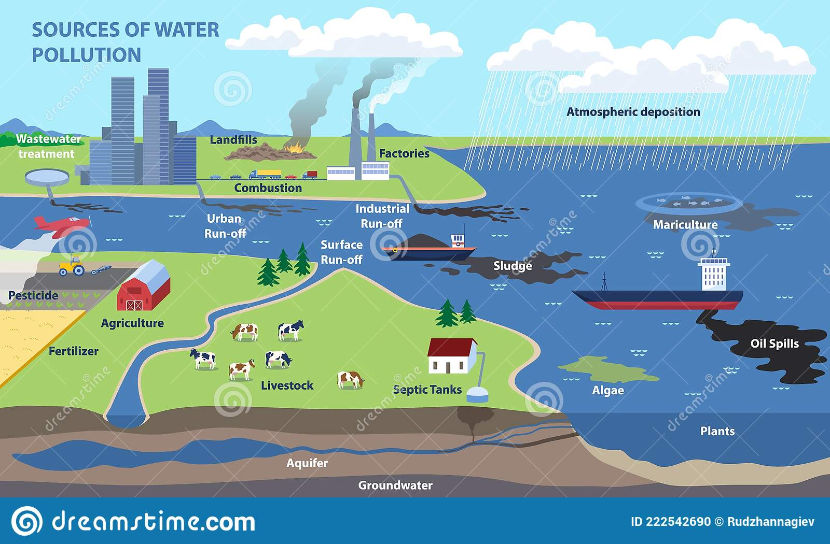
SOURCES OF WATER POLLUTION

Slide 7
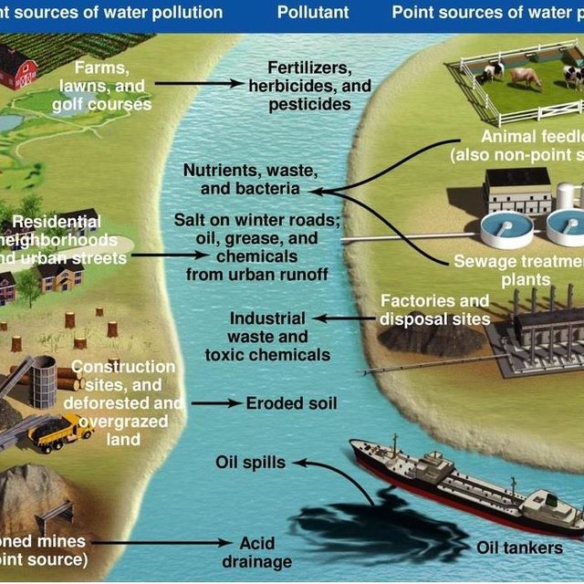

Slide 8
What is called Waste water?
Water that has been used in the home, in a business, or as part of an industrial process.
(Source: Oxford Dictionary)
Water that has been used in washing, flushing, manufacturing etc.
(Source: http://www.dictionary.com)

Slide 9
Wastewater: A burden or A resource ?
Burden: As it Contains pollution
Resource: Generally, > 99% fraction is water
What is Wastewater Treatment ?
Processing of wastewater for removal
of contaminants

Slide 10
Why learn wastewater management ?
To transform the “burden” into “resource”
This Requires:
Engineering/Technological approaches
Social acceptability
Financial / economic viability
Environmental sustainability

Slide 11
S1-SLO2- Sources and Types of water pollution
Wastewater is liquid waste, often produced as the byproduct of many uses of water.
Household uses
Industrial uses
Commercial uses
Agricultural uses
Livestock uses

Slide 12
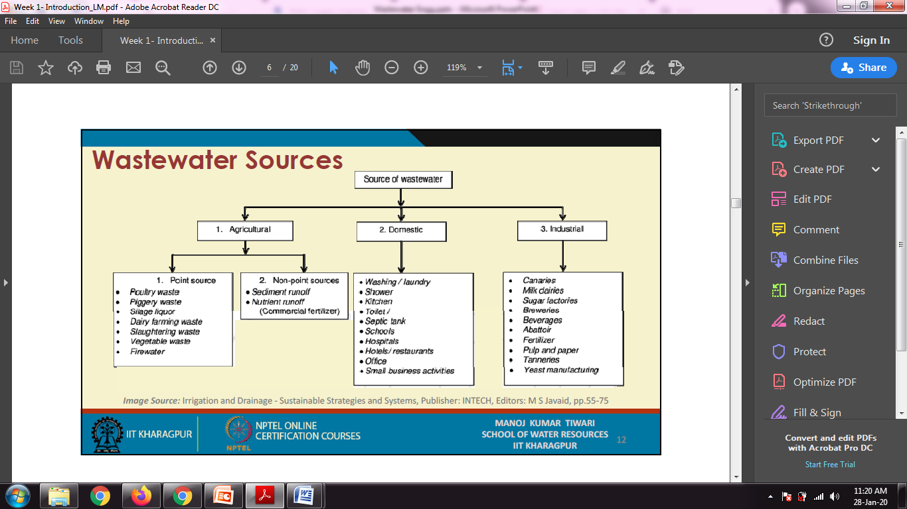
Image Source: Irrigation and Drainage ‐ Sustainable Strategies and Systems, Publisher: INTECH, Editors: M S Javaid, pp.55‐75

Slide 13
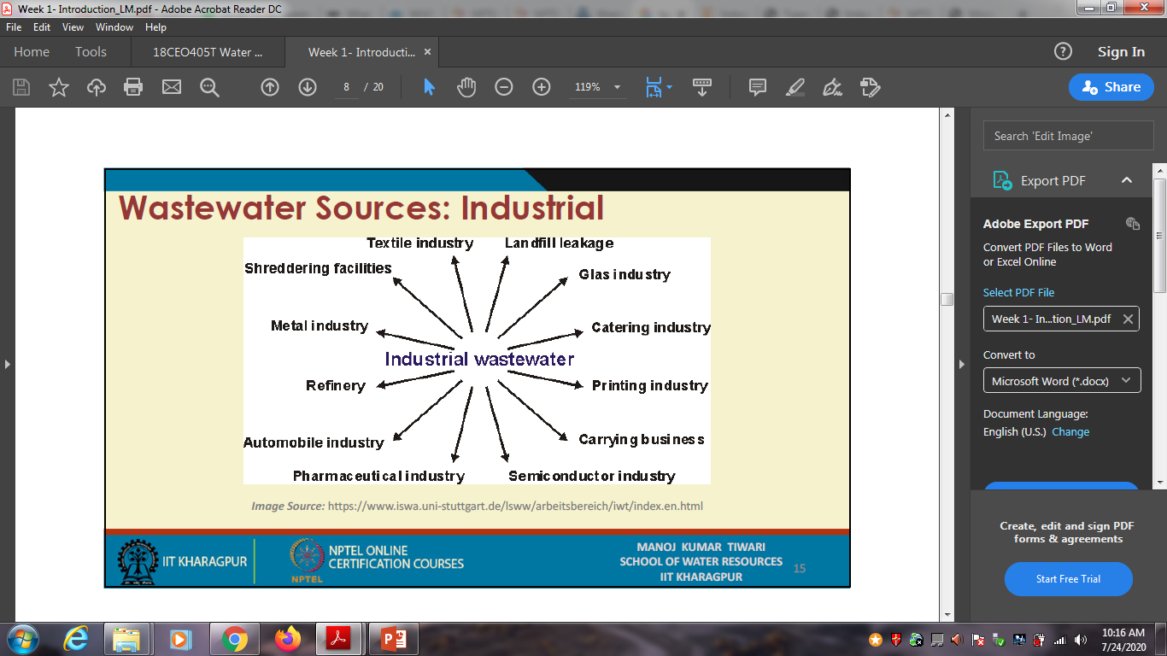
Image Source: https://www.iswa.uni-stuttgart.de/Isww/arbeitsbereich/iwt/index.en.html

Slide 14
Types of Waste water
Domestic Wastewater
(Municipal wastewater or sewage)
Industrial Wastewaters
(Industrial effluents)
Agricultural wastewater
(Agricultural runoff)
Storm water Runoff

Slide 15
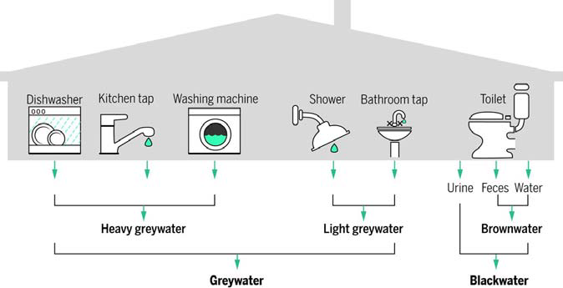
Types & Generation of Domestic Waste water
Image Source: Larsen et al, (2016), Emerging solutions to the water challenges of an urbanizing world, Science , 352 (6288), pp. 928‐933

Slide 16
Classification of water pollution
S2-SLO1- Point source and non point source pollution
Water pollution is any chemical, biological, or physical change in water quality that has a harmful effect on living organisms or makes water unsuitable for desired uses.
Point source: specific location (drain pipes, ditches, sewer lines).
Nonpoint source: cannot be traced to a single site of discharge (atmospheric deposition, agricultural / industrial / residential runoff)

Slide 17
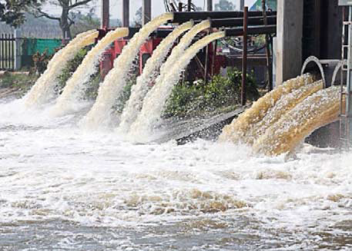
Classification of water pollution
Nonpoint source : Surface run off
Point source: Industrial effluent disposal
Image Source:
http://www.deeproot.com/blog/blog‐entries/whats‐the‐pointof‐
non‐point
Image Source: http://www.indiacelebrating.com/environmentalissues/
sources‐and‐causes‐of‐water‐pollution/

Slide 18
Classification of water pollution- Cntd.,
Source: http://ubclfs‐wmc.landfood.ubc.ca/webapp/IWM/course/land‐use‐water‐4/introduction‐5/

Slide 19
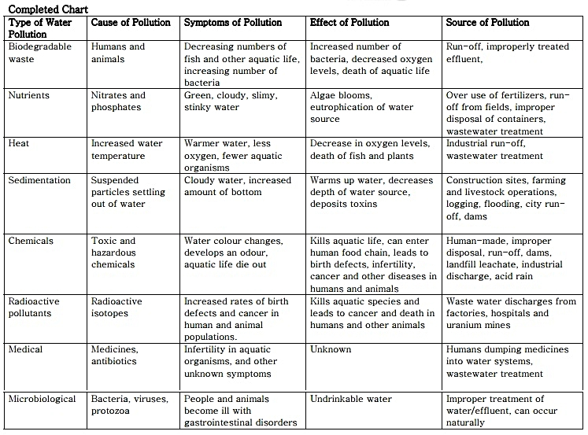
WATER POLLUTANT AND CAUSES

Slide 20
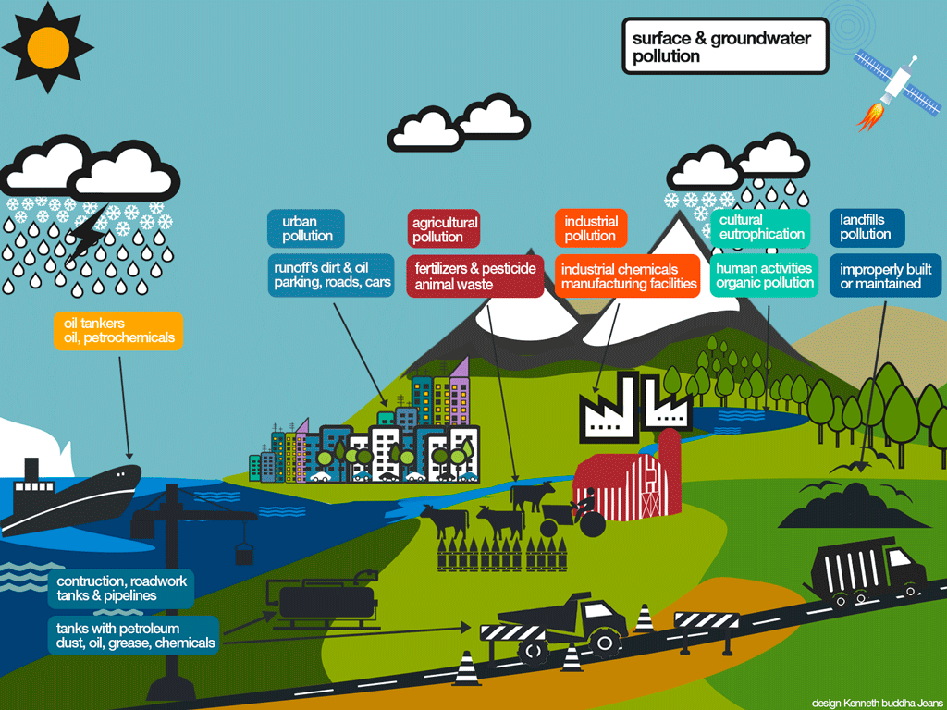
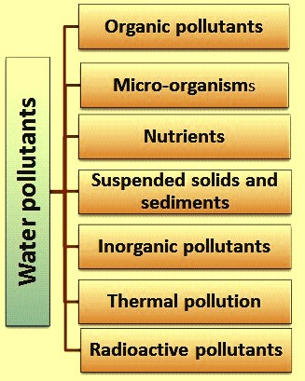
S2-SLO2- Types of pollutant
Types Of Water Pollutants

Slide 21
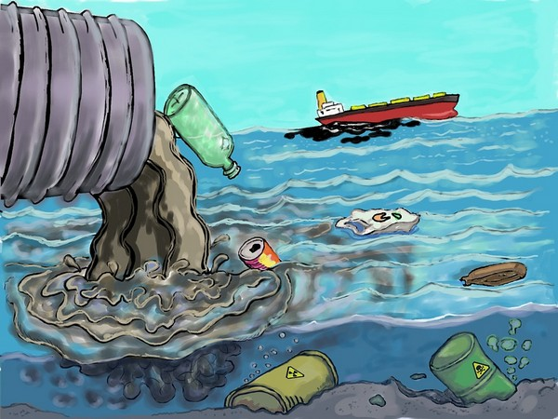
S2-SLO2- Types of pollutant
Organic Pollutants : It can be further divided into following categories:
Oxygen Demanding wastes: The wastewaters such as, domestic and municipal sewage, wastewater from food processing industries, canning industries, slaughter houses, paper and pulp mills, tanneries, breweries, distilleries, etc. have considerable concentration of biodegradable organic compounds either in suspended, colloidal or dissolved form.
These wastes undergo degradation and decomposition by bacterial activity.
Inorganic pollutants: Acids, Toxic metals and etc
Organic pollutants : Pesticides, Oil and etc

Slide 22
S2-SLO2- Types of pollutant
Synthetic Organic Compounds :
Synthetic organic compounds are also likely to enter the ecosystem through various manmade activities such as production of these compounds, spillage during transportation, and their uses in different applications.
These include synthetic pesticides, synthetic detergents, food additives, pharmaceuticals, insecticides, paints, synthetic fibers, plastics, solvents and volatile organic compounds (VOCs).

Slide 23
S2-SLO2- Types of pollutant
Synthetic Organic Compounds :
Most of these compounds are toxic and bio-refractory organics i.e., they are resistant to microbial degradation. Polychlorinated biphenyls (PCBs) are used in the industries since 1930s which are complex mixtures of chlorobiphenyls
Inorganic pollutants- includes a variety of toxic heavy metals such as cadmium (Cd), chromium (Cr), arsenic (As), lead (Pb), mercury (Hg), etc. Copper greater than 0.1 mg/L is toxic to microbes.

Slide 24
S2-SLO2- Types of pollutant
Pathogens:
The pathogenic microorganisms enter in to water body through sewage discharge as a major source or through the wastewater from industries like slaughterhouses.
Viruses and bacteria can cause water borne diseases, such as cholera, typhoid, dysentery, polio and infectious hepatitis in human.
Nutrients:
The agriculture run-off, wastewater from fertilizer industry and sewage contains substantial concentration of nutrients like nitrogen and phosphorous.

Slide 25
S2-SLO2- Types of pollutant
Nutrients:
In long run, water body reduces DO, leads to eutrophication and ends up as a dead pool of water. People swimming in eutrophic waters containing blue-green algae can have skin and eye irritation, gastroenteritis and vomiting.
High nitrogen levels in the water supply, causes a potential risk, especially to infants under six months Eg., Blue baby disease.
In freshwater systems, eutrophication is a process whereby water bodies receive excess inorganic nutrients, especially N and P, which stimulate excessive growth of plants and algae.

Slide 26
S2-SLO2- Types of pollutant
Nutrients (Contd):
Eutrophication can happen naturally in the normal succession of some freshwater ecosystems. the rate of this natural process is greatly intensified.
Two major nutrients, nitrogen (N) and phosphorus (P), occur in streams in various forms as ions or dissolved in solution. Aquatic plants convert dissolved inorganic forms of nitrogen (nitrate, nitrite, and ammonium) and phosphorus (orthophosphate) into organic or particulate forms for use in higher trophic production. may develop.

Slide 27
S2-SLO2- Types of pollutant
Suspended solids and sediments:
These comprise of silt, sand and minerals eroded from land. These appear in the water through the surface runoff during rainy season and through municipal sewers.
This can lead to the siltation, reduces storage capacities of reservoirs. Presence of suspended solids can block the sunlight penetration in the water, which is required for the photosynthesis by bottom vegetation.

Slide 28
S2-SLO2- Types of pollutant
Suspended solids and sediments: Cntd.,
Deposition of the solids in the quiescent stretches of the stream or ocean bottom can impair the normal aquatic life and affect the diversity of the aquatic ecosystem.
If the deposited solids are organic in nature, they will undergo decomposition leading to development of anaerobic conditions. Finer suspended solids such as silt and coal dust may injure the gills of fishes and cause asphyxiation.

Slide 29
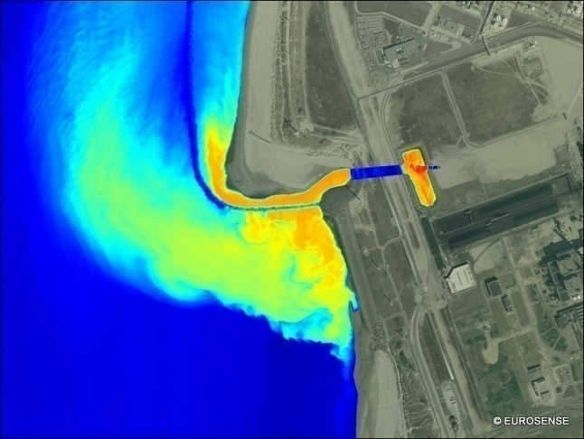
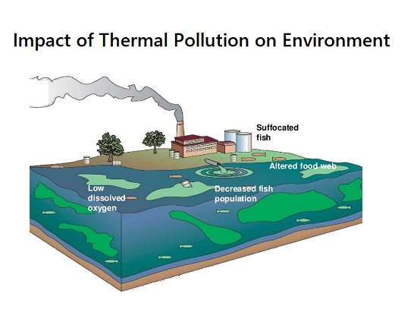
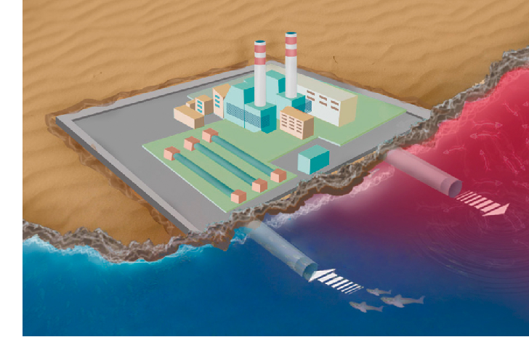
S2-SLO2- Types of pollutant
Thermal pollution:
Considerable thermal pollution results due to discharge of hot water from thermal power plants, nuclear power plants, and industries where water is used as coolant.
As a result of hot water discharge, the temperature of water body increases. Rise in temperature reduces the DO content of the water, affecting adversely the aquatic life.
This alters the spectrum of organisms, which can adopt to live at that temperature and DO level.

Slide 30
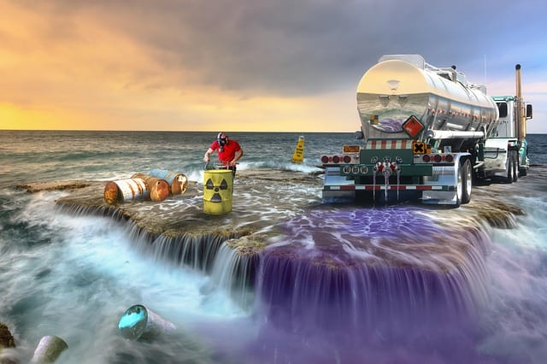
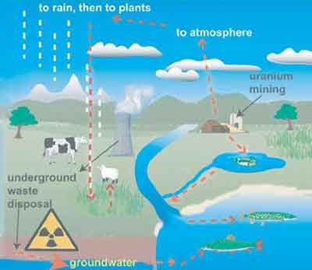
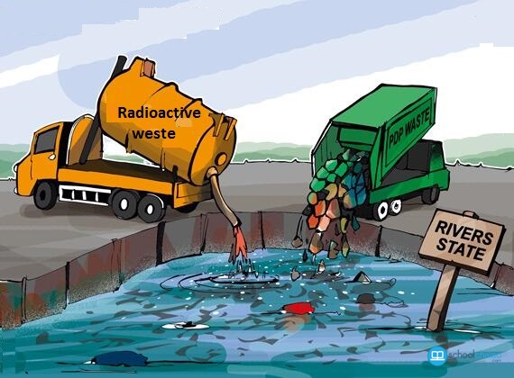
S2-SLO2- Types of pollutant
Radioactive pollutants:
Radioactive materials originate from the following:
Mining and processing of ores. Use in research, agriculture, medical and industrial activities, such as I131, P32, Co60, Ca45, S35, C14, etc.
Radioactive discharge from nuclear power plants and nuclear reactors, e.g., Sr90, Cesium Cs137, Plutonium Pu248, Uranium-238, Uranium-235. Uses and testing of nuclear weapons. These isotopes are toxic to the life forms; they accumulate in the bones, teeth and can cause serious disorders.

Slide 31
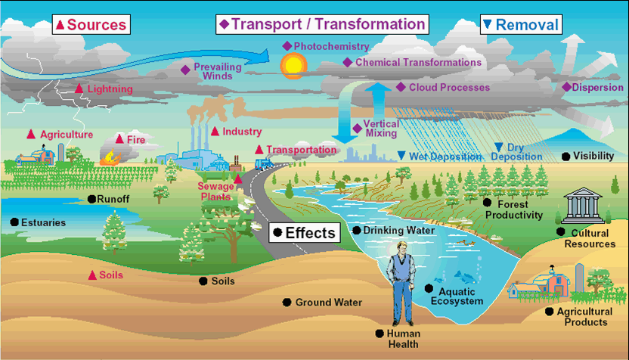
S3-SLO1- Adverse effects of pollutants

Slide 32
S3-SLO1- Adverse effects of pollutants
Diseases: In humans, drinking or consuming polluted water in any way has many disastrous effects on our health. It causes typhoid, cholera etc.,
Destruction of Ecosystems: These are extremely dynamic and respond to even small changes in the environment. Water pollution can cause an entire ecosystem to collapse if left unchecked.

Slide 33
S3-SLO1- Adverse effects of pollutants
Eutrophication: Chemicals in a water body, encourage the growth of algae. These algae form a layer on top of the pond or lake. Bacteria feed on this algae and this decreases the amount of oxygen in the water body, severely affecting the aquatic life there.
Effects the food chain: Disruption in food chains happens when toxins and pollutants in the water are consumed by aquatic animals (fish, shellfish etc) which are then consumed by humans.

Slide 34
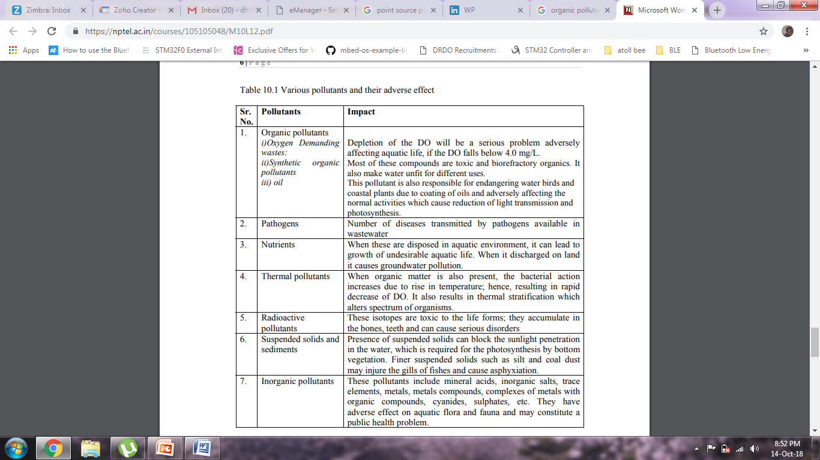
S3-SLO1- Adverse effects of pollutants

Slide 35
S3-SLO2- Principles of pollution assessment
Pollution assessment is the systematic identification and evaluation of the potential impacts(effects) of proposed projects, plans, programs or legislative actions relative to the physical- chemical, biological, cultural and socioeconomic components of the total environment. It is classify into the following categories
Physical Assessment
Chemical Assessment &
Biological Assessment

Slide 36
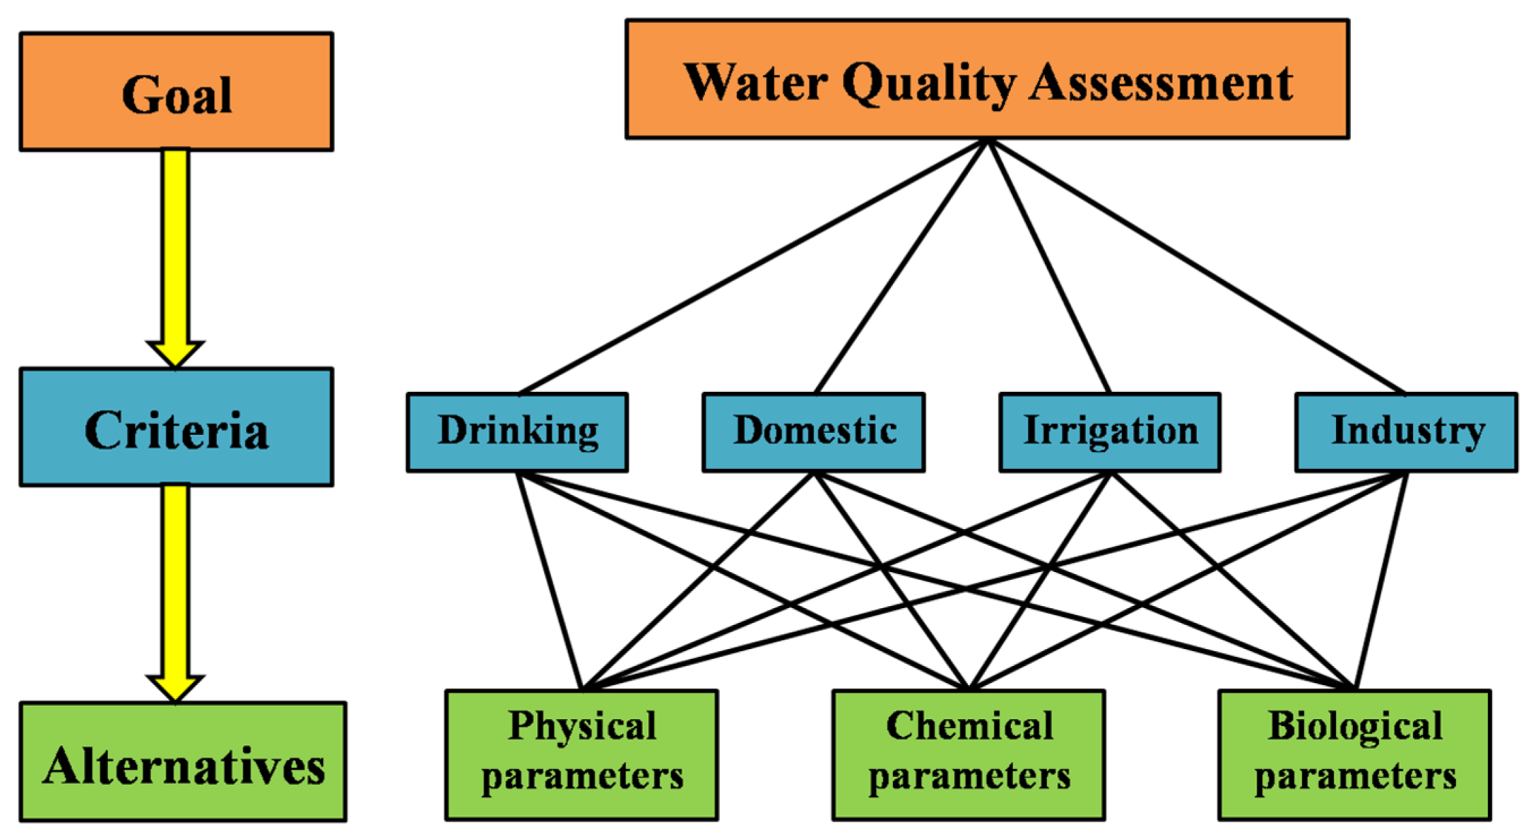
S3-SLO2- Principles of pollution assessment

Slide 37
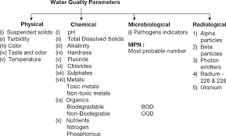
S3-SLO2- Principles of pollution assessment

Slide 38
S4-SLO1- Terms and Definitions in wastewater
Wastewater: The term wastewater includes both organic and inorganic constituents, in soluble or suspended form, and mineral content of liquid waste carried through liquid media.
Generally the organic portion of the wastewater undergoes biological decompositions and the mineral matter may combine with water to form dissolved solids.
Stormwater: It indicates the rain water of the locality.
Night Soil: It is a term used to indicate the human and animal excreta.

Slide 39
S4-SLO1- Terms and Definitions in wastewater
Industrial wastewater: It is the wastewater generated from the industrial and commercial areas. This wastewater contains objectionable organic and inorganic compounds that may not be amenable to conventional treatment processes.
Sullage: This refers to the wastewater generated from bathrooms, kitchens, washing place and wash basins, etc. Composition of this waste does not involve higher concentration of organic matter and it is less polluted water as compared to sewage.

Slide 40
S4-SLO1- Terms and Definitions in wastewater
Sewage: It indicates the liquid waste originating from the domestic uses of water. It includes sullage, discharge from toilets, urinals, wastewater generated from commercial establishments, institutions, industrial establishments and also the groundwater and storm water that may enter into the sewers. Its decomposition produces large quantities of malodorous gases, and it contains numerous pathogenic or disease producing bacteria, along with high concentration of organic matter and suspended solids.

Slide 41
S4-SLO1- Terms and Definitions in wastewater
Sanitary sewage: Sewage originated from the residential buildings comes under this category. This is very foul in nature.
It is the wastewater generated from the lavatory basins, urinals and water closets of residential buildings, office building, theatre and other institutions. It is also referred as domestic wastewater.
Sewer: It is an underground conduit or drain through which sewage is carried to a point of discharge or disposal. There are three types of sewer systems that are commonly used for sewage collection. 1) Separate sewer 2) Combined sewer 3) Storm sewer.

Slide 42
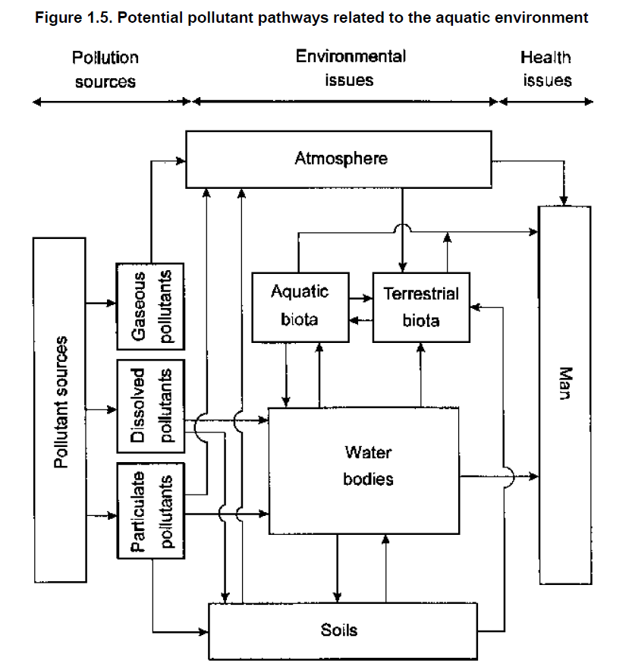
S4-SLO2- Transport of pollutants

Slide 43
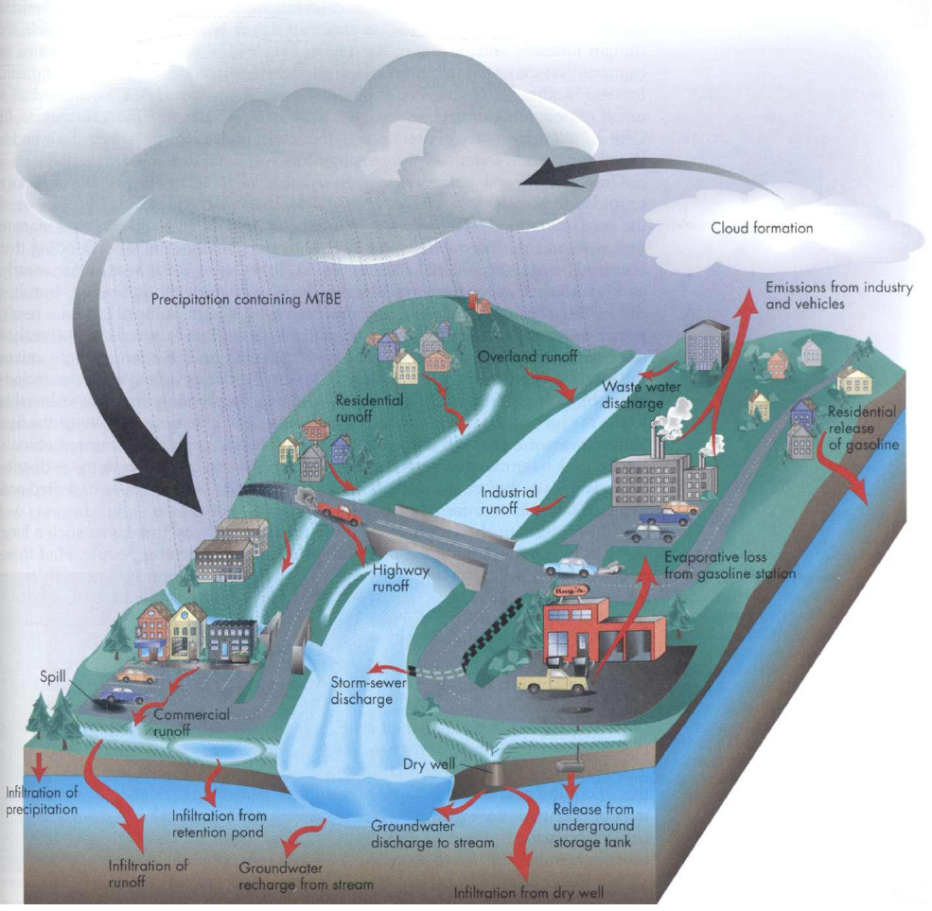
S4-SLO2- Transport of pollutants

Slide 44
S4-SLO2- Transport of pollutants
The dissolved transport in waters is very important since this is highly associated with more available forms of pollutants of greater environmental concern.
In addition, by this way pollutants can more easily reach other sites or environmental compartments way from the source.
Primarily, this involves leaching processes, i.e., a process by which pollutants are released from solid phase into the aqueous phase under the influence of dissolution and desorption of pollutants from their support-phases.

Slide 45
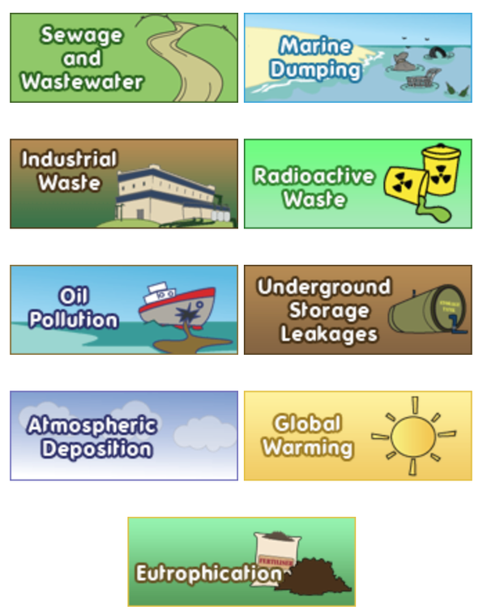
S5-SLO1- Causes of Water pollution
Urbanization
Deforestation
Destruction of Wetland
Dumping of waste
Mining's
Global warming
Acid rain
Oil pollution

Slide 46
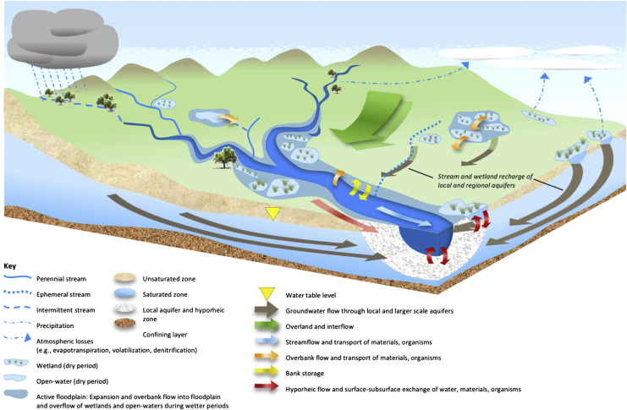
S5-SLO2- Hydrology cycle
Source : http://ngojwg.org/study3‐2‐e.html

Slide 47
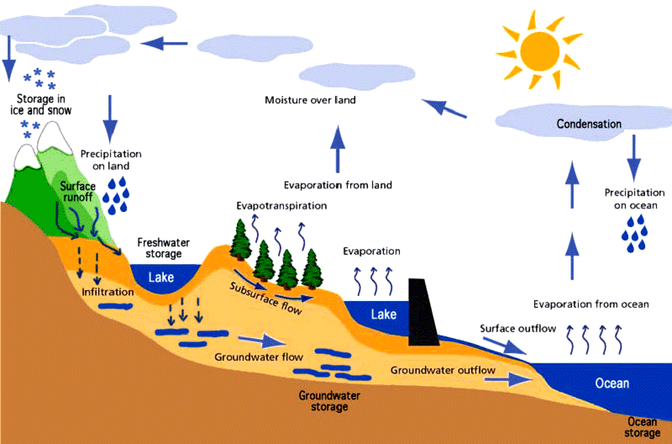
S5-SLO2- Hydrology cycle
Source : http://ngojwg.org/study3‐2‐e.html

Slide 48
S5-SLO2- Hydraulic flow of water pollution
Transport Dilution
Sediment transport Sedimentation
Advection Diffusion
Dispersion Leaching
Filtration Adsorption
Hydrolysis Biodegradation
Photodecomposition
Source : http://ngojwg.org/study3‐2‐e.html

Slide 49
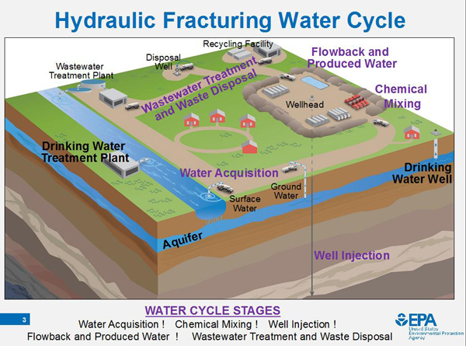
S5-SLO2- Hydraulic flow of water pollution
Source : http://ngojwg.org/study3‐2‐e.html

Slide 50
S6-SLO1- Water sampling
Sampling:
The process of collecting a representative portion of water, as from the natural environment or from an industrial site, for the purpose of analyzing it for constituents.
The process of taking a portion of water for analysis or other testing
E.g drinking water to check that it complies or river water to check for pollutants, or bathing water to check that it is safe.

Slide 51
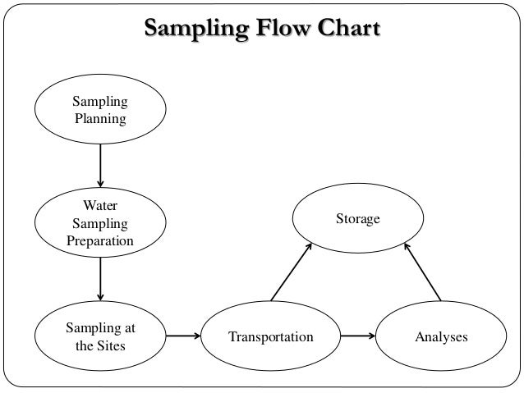
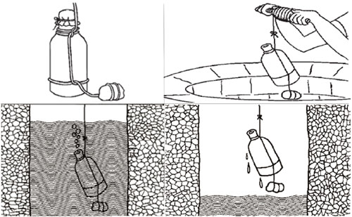
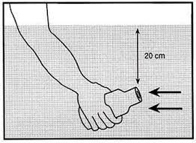
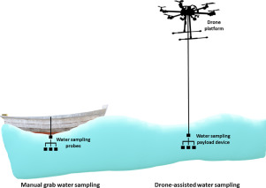
S6-SLO1- Sampling procedure

Slide 52
S4-SLO2- Transport of pollutants
The transport of pollutants in water can occur under particulate or dissolved forms, either in surface or groundwater.
In surface water, soil particles can be introduced in streams and move under particulate form downstream (bed-load transport) by rolling, sliding, and saltation and further deposited downstream.
It depends on flow velocity, turbulence, and grain size, shape, and density. In groundwater, particulate transport is not so expressive and occurs for very small grain size particles.

Slide 53
S6-SLO1- Sampling procedure
Sampling:
Objective of sampling is to collect a portion of material small enough in volume to be transported comfortably and yet large enough for analytical purposes while still representing the material being sampled.
A clean pair of new, non-powdered, disposable gloves will be worn each time a different location is sampled and the gloves should be donned immediately prior to sampling. The gloves should not come in contact with the media being sampled and should be changed any time during sample collection when their cleanliness is compromised.

Slide 54
S6-SLO1- Sampling procedure
Sample containers for samples suspected of containing high concentrations of contaminants shall be stored separately.
Sample collection activities shall proceed progressively from the least suspected contaminated area to the most suspected contaminated area.
Samples of waste or highly contaminated media must not be placed in the same ice chest as environmental (i.e., containing low contaminant levels) or background/control samples.

Slide 55
S6-SLO1- Sampling procedure
If possible, one member of the field sampling team should take all the notes and photographs, fill out tags, etc., while the other members collect the samples.
Field investigators must use new, verified certified-clean disposable or non disposable equipment cleaned according to their procedures

Slide 56
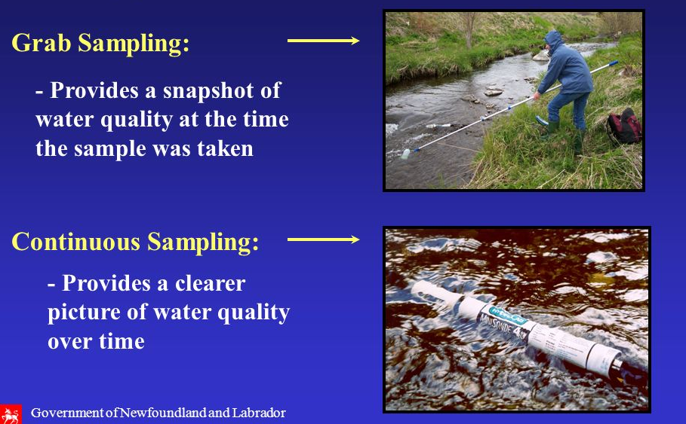
S6-SLO2- Methods of Sampling and Storage
Types of Sampling:
Dip or Grab sampling
Composite sampling
Integrated sampling
Dip or Grab sampling : Water samples are usually obtained by filling a container held beneath the surface of the water. A sample taken at a specific time and point which gives an indication of the water quality at that point in time.
A properly taken grab sample is a snap shot of the quality of the water at the exact time and place the sample was taken. Depending on the water body, grab samples may be taken by simply dipping a sample bottle in the water body, or they may require the use of specific sampling devices.

Slide 57
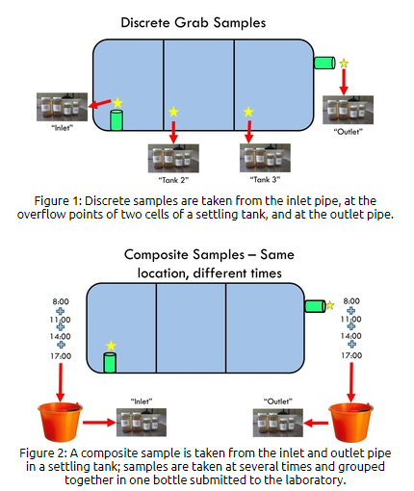

Slide 58
S6-SLO2- Methods of Sampling and Storage
The discrete grab sample is one that is taken at a selected location, depth, and time and then analyzed for the constituents of interest.
A Depth-Integrated Grab Sample is collected over a predetermined part or the entire depth of the water column, at a selected location and time, in a given body of water, and then analyzed for the constituents of interest.
The primary advantage of grab samples is that sometimes very little equipment is required for sample collection and there is flexibility in sampling location selection. However, this method sacrifices data resolution because of the smaller number of samples that are usually collected

Slide 59
S6-SLO2- Methods of Sampling and Storage
Composite sampling: are usually obtained by mixing equal volumes of discrete grab samples (collected at one point at regular time intervals. A composite sample provides an estimate of average water quality conditions. Various sample intervals and subsample volumes can be set.
A composite sample is a mixture of grab samples taken at different times or locations and pooled together to provide one sample.

Slide 60
S6-SLO2- Methods of Sampling and Storage
The advantage of composite sampling is that it gives you an idea of the average condition of a water body over time, (samples taken at different times and mixed together) or space, (samples taken at different locations within the water body).
This is particularly useful in water bodies that have a lot of chemical variability either over space or over short time periods. Composite samples are often used to reduce the cost of analyzing a large number of samples.
This method also has its limitations. Individual sample information is lost and you lose the ability to mathematically assess the variability.

Slide 61
S6-SLO2- Methods of Sampling and Storage
Integrated sampling : is carried out by collecting mixture of grab samples collected from different points simultaneously. The points may be horizontal or vertical variation.
Examples include river, stream or reservoir or lake that varies in composition across the width and depth. Also in industries that have different streams and combined treatment is proposed, than integrated sampling of different streams can be made to understand the significant effect on treatment.

Slide 62
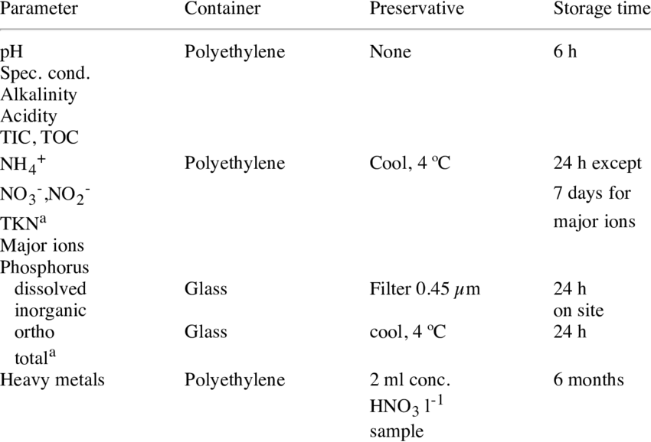

Slide 63
S7-SLO1- Effects of water pollution
Water-borne diseases account for the deaths of 3,575,000 people a year! That’s equivalent to a jumbo jet crashing every hour, and the majority of these are children.
Infectious diseases can be spread through contaminated water. Some of these water-borne diseases are Typhoid, Cholera, Paratyphoid Fever, Dysentery, Jaundice, Amoebiasis and Malaria.
Chemicals in the water also have negative effects on our health.

Slide 64
S7-SLO1- Effects of water pollution
Pesticides – can damage the nervous system and cause cancer because of the carbonates and organophosphates that they contain. Chlorides can cause reproductive and endocrinal damage.
Lead – can accumulate in the body and damage the central nervous system.
Arsenic – causes liver damage, skin cancer and vascular diseases
Flourides - in excessive amounts can make your teeth yellow and cause damage to the spinal cord.– even with very low exposure, can cause cancer.

Slide 65
S7-SLO2- Eutrophication
Eutrophication can happen naturally in the normal succession of some freshwater ecosystems. However, when the nutrient enrichment is due to the activities of humans, sometimes referred to as “cultural eutrophication”, the rate of this natural process is greatly intensified.
Two major nutrients, nitrogen (N) and phosphorus (P), occur in streams in various forms as ions or dissolved in solution. Aquatic plants convert dissolved inorganic forms of nitrogen (nitrate, nitrite, and ammonium) and phosphorus (orthophosphate) into organic or particulate forms for use in higher trophic production.

Slide 66
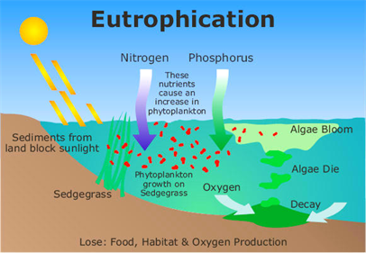
S7-SLO2- Eutrophication

Slide 67
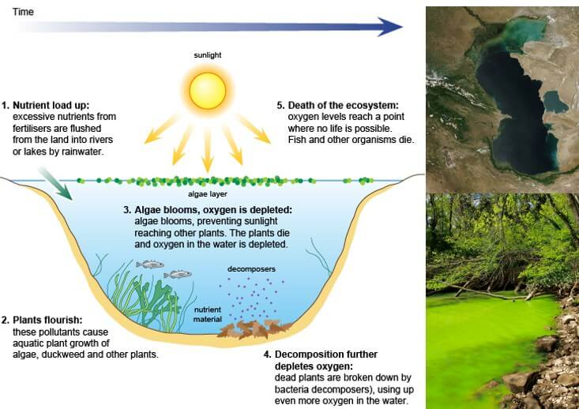
S7-SLO2- Eutrophication

Slide 68
S7-SLO2- Eutrophication
The main effects caused by eutrophication can be summarized as follows:
Species diversity decreases and the dominant biota changes.
Plant and animal biomass increase.
Turbidity increases.
Rate of sedimentation increases, shortening the lifespan of the lake.
Anoxic conditions may develop.

Slide 69
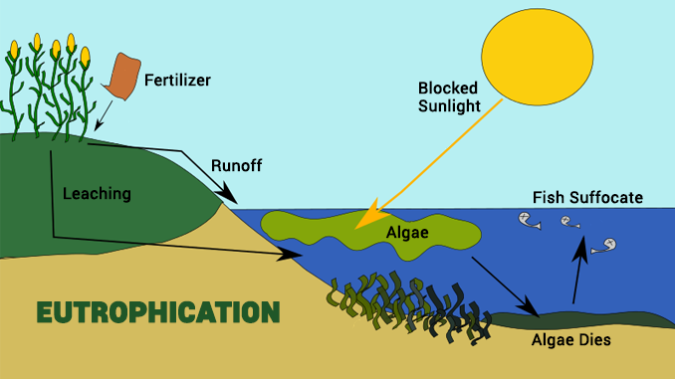
S7-SLO2- Eutrophication
Source : http://quizlet.com/291485834/eutrohication-diagram/

Slide 70
S8-SLO1- Public awareness and participation in water pollution
Water conservation
Hygienic water use
Preservation of ecosystem
Public environmental awareness is one of the most important indicators for displaying national civilization.
It reflects many aspects of environmental status, such as peoples knowledge, personal consideration and behaviour, public capacity, and the local citizen’s attitudes towards a sustainable society as a whole.

Slide 71
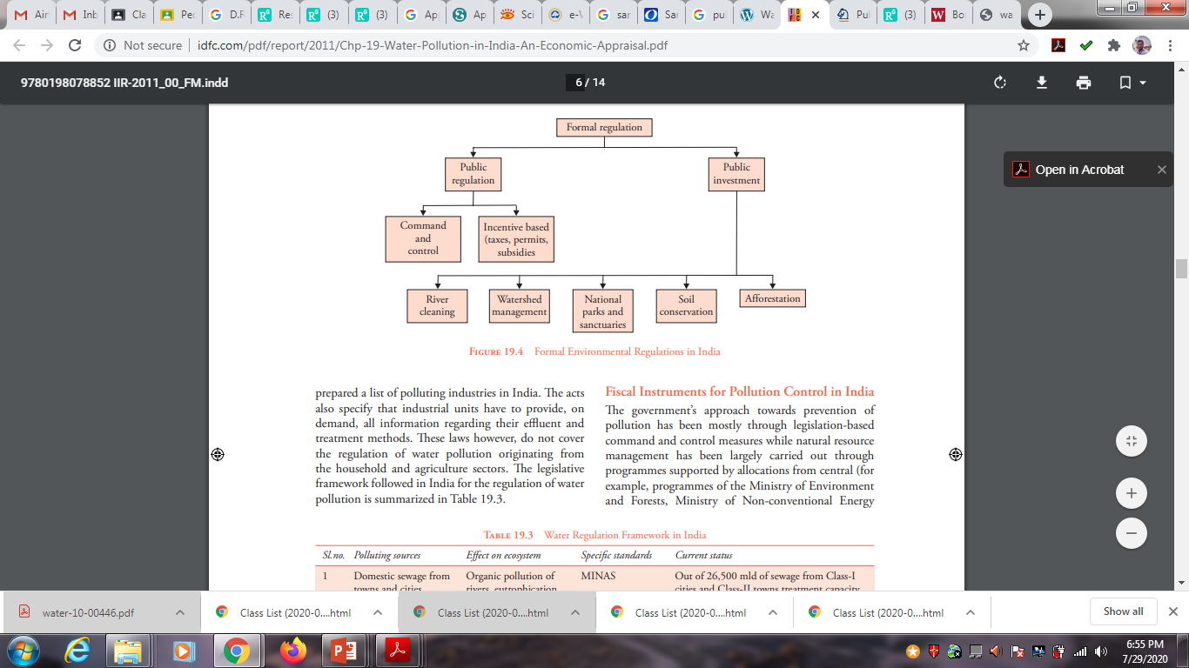
S8-SLO1- Public awareness and participation in water pollution
Source : http://www.idfc.com/pdf/report/2011/Chp-19-Water-Pollution-in-India-An-Economic-Appraisal.pdf

Slide 72
S8-SLO2- Industries and their role in water pollution
The wastewater from industries varies so greatly in both flow and pollution strength. So, it is impossible to assign fixed values to their constituents.
In general, industrial wastewaters may contain suspended, colloidal and dissolved (mineral and organic) solids.
In addition, they may be either excessively acid or alkaline and may contain high or low concentrations of colored matter. These wastes may contain inert, organic or toxic materials and possibly pathogenic bacteria

Slide 73
S8-SLO2- Industries and their role in water pollution
Types of Industrial Effluents
Tannery Battery manufacturing.
Electric power plants Food industry.
Iron and steel industry Mines and quarries.
Distillery Nuclear industry
Pharmaceutical Dairy industry
Petroleum refining and petrochemicals.
Paper and pulp industries
Organic chemicals manufacturing.

Slide 74
Thank you

